Slide 1
PicVerse A Social Media Photo Sharing Platform
Group ID :-14 202412026 Jain Tisha Navinkumar
202412032 Kaival Shah
202412066 Patel Dhruv Alkeshbhai

Slide 2
Group Leader & Task Assignments
Group Leader: Patel Dhruv Alkeshbhai
Roles & Work Distribution:
Kaival Shah
Backend Lead: Authentication, OTP, Messaging system, Server Monitoring
Completed: Auth flow, OTP registration, Messaging logic, Admin features [Ban –Unban users]
Tisha Jain
Frontend Lead: Profile UI, Upload UI, Follow/Unfollow, Explore UI
Completed: Profile & upload interface, search/follow UI, : Messaging UI, Testing, Badge Assignment.
Dhruv Patel
DB & Integration: Schema design, DB connectivity, Feature testing
Completed: DB schema for users, posts, comments, API integration, analytics dashboard , Manage Admins [Add-Delete] , Discussion Forums

Slide 3
Objectives of the Project
Create an intuitive platform to share photos socially
Develop a secure and user-friendly image-sharing platform for students and creators.
Enable user interactions (like, comment, follow)
Provide private messaging and user search features
Include moderation features (admin control, banning)
Ensure scalability and secure backend performance.
Ensure responsive UI design and personalized user profiles.

Slide 4
Milestones of the Project
Sprint 1 (March 09 – March 16) focused on user onboarding and security. We implemented a secure user authentication system with hashed passwords, OTP verification for new users, and password recovery via email.
Sprint 2 (March 16 – March 23) targeted social interactions. We developed the follow/unfollow feature to help build user networks and added real-time like and comment functionalities for post engagement
Sprint 3 (March 23 – March 30) emphasized content sharing and profile customization. Users gained the ability to upload images, update their profile details including bio and links, and add a profile picture.
Sprint 4 (March 30 – April 06) introduced discovery and communication features. We built a user search system and integrated a real-time chat interface for private conversations.
Sprint 5 (April 06 – April 13) concentrated on admin controls and performance monitoring. We created a public discussion forum, added admin tools to ban users, and implemented a dashboard to monitor server performance and metrics.

Slide 5
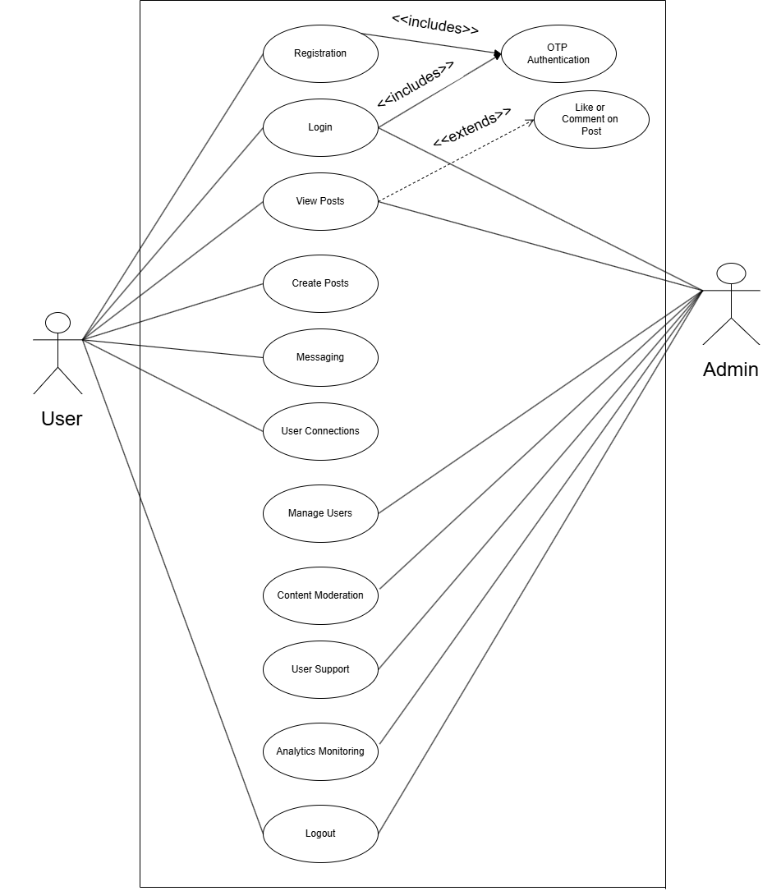
Use Case

Slide 6
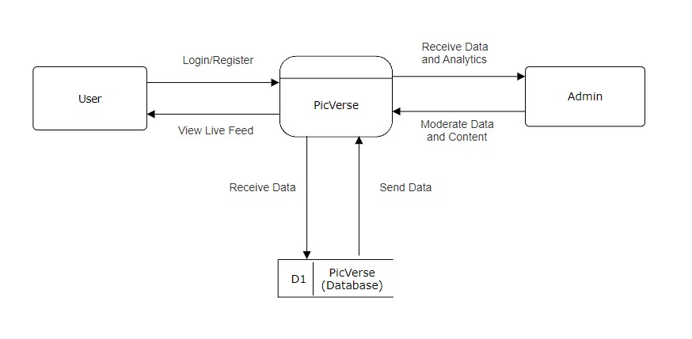
Level 0 DFD

Slide 7
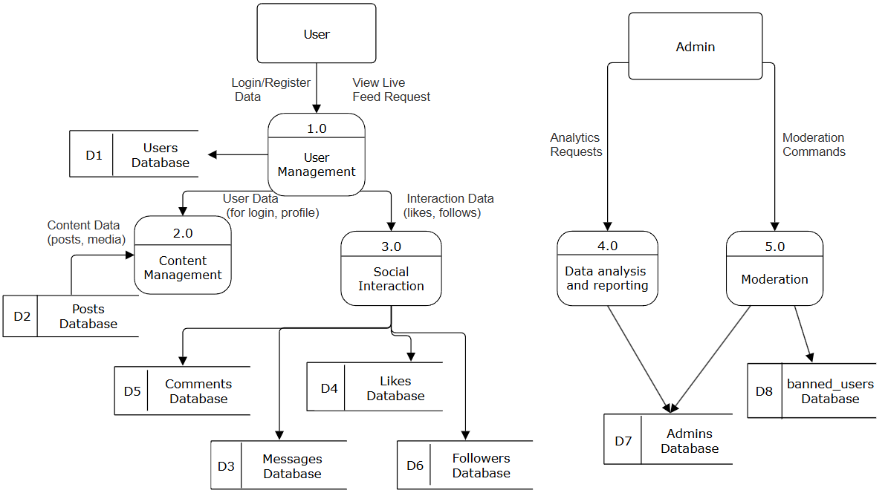
Level 1 DFD

Slide 8
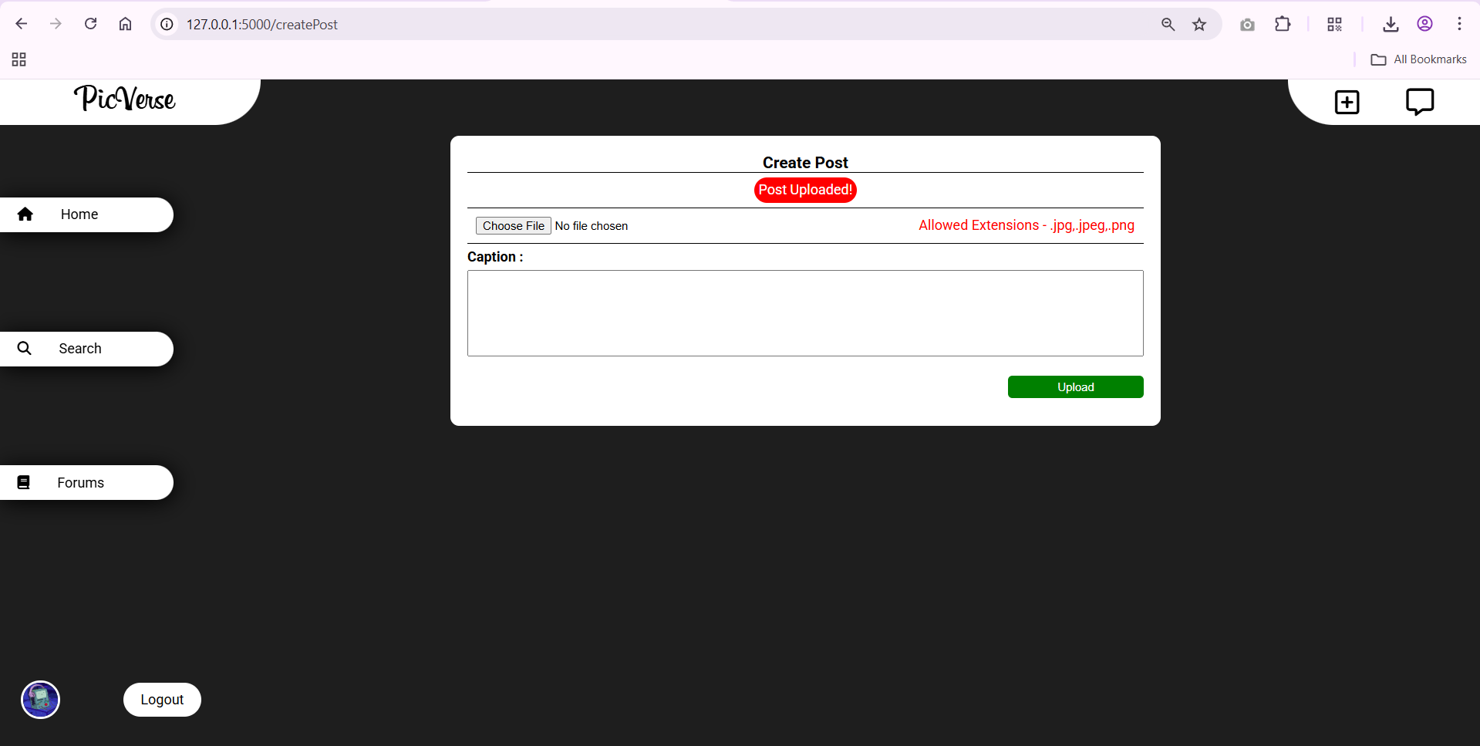
Create Posts

Slide 9
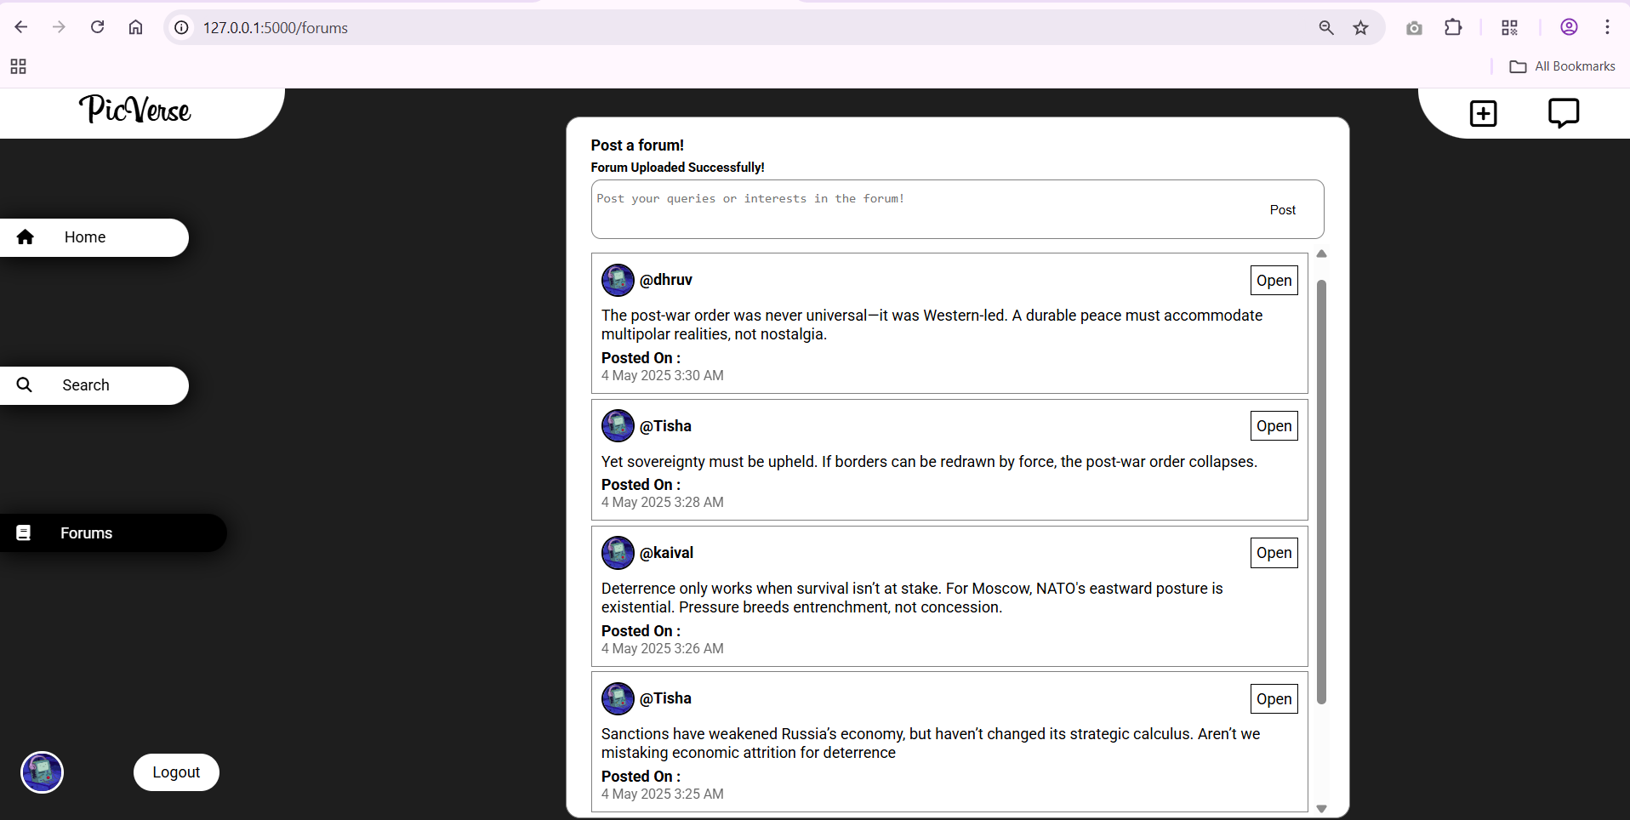
Discussion Forums

Slide 10
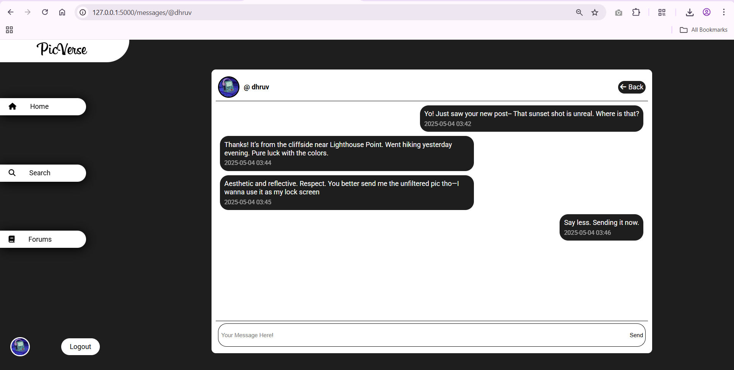
Message Users

Slide 11
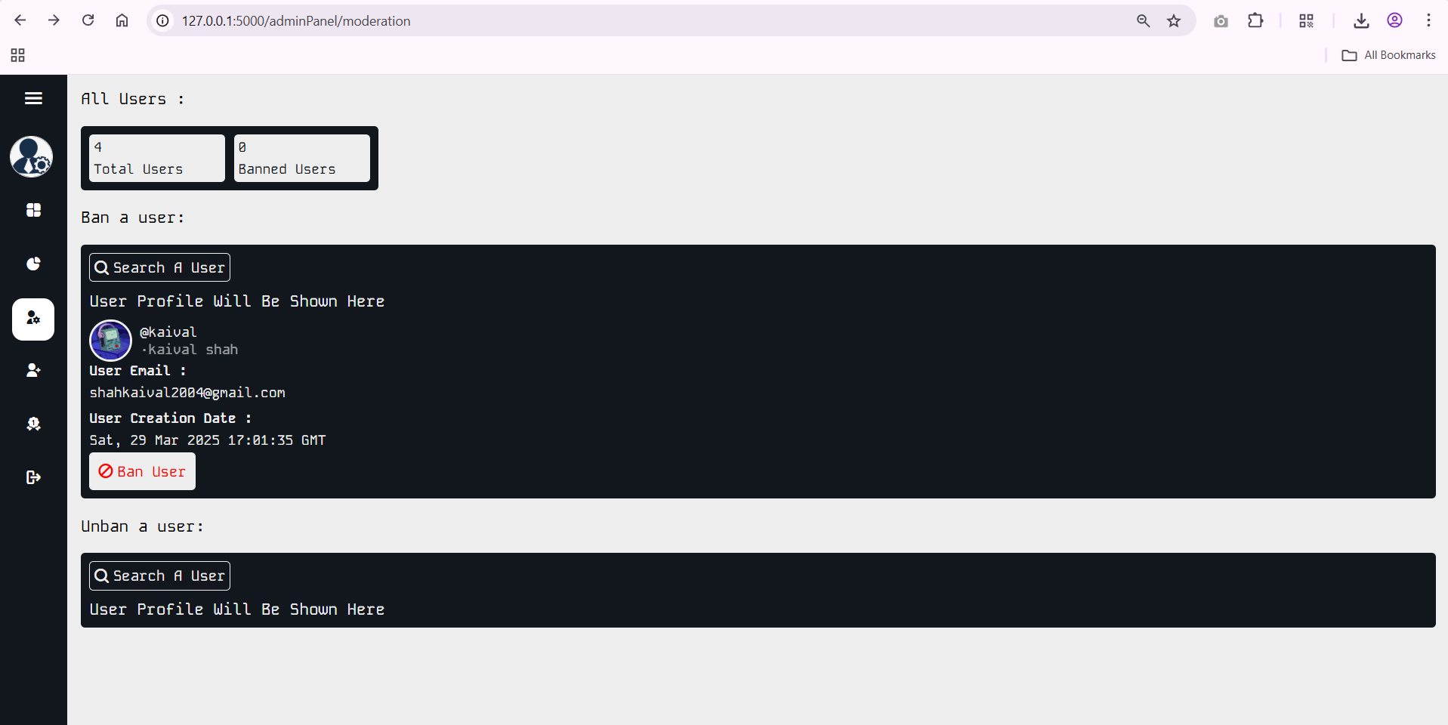
Ban Unban Users

Slide 12
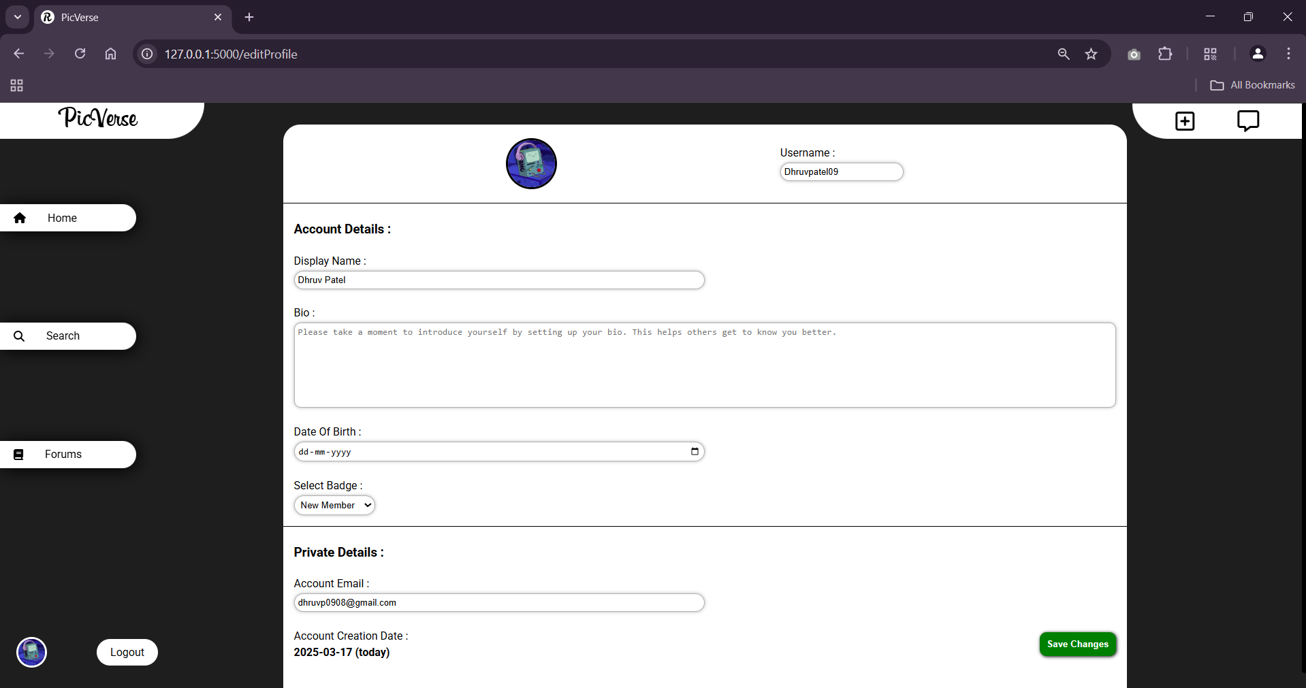
Edit Profile

Slide 13
Lessons Learnt / Key Takeaways
Importance of agile planning and sprint retrospectives.
Importance of clear requirement gathering before development.
Better coordination and communication helps resolve issues early.
Regular testing during development helps catch bugs faster.
Need for early backend–frontend sync.
Understanding user expectations is crucial for designing features.
Value of modular testing during integration.
Handling real-time features (messaging, notifications).
Realized the importance of documenting each phase properly.

Slide 14
Achievements & Contributions
Successfully implemented OTP and secure login.
Dynamic post sharing with real-time interactions
Functional messaging and search systems
Functional messaging and search systems
Smooth UI/UX for all user interactions
Team collaboration via version control and sprints
Achieved bug tracking and sprint tracking using version control commits and test logs.

Slide 15
Mistakes Identified
Initial delays due to unclear module boundaries
Faced sprint delays due to underestimating time for complex modules like OTP and chat.
Forgetting to back up database or code led to minor setbacks.
Encountered miscommunication and version conflicts in the early development phase
Some confusion due to unclear task division early in the project.
Missed setting up consistent naming conventions in early commits.
Integration testing began late, leading to last-minute bug fixing.
Prioritized coding over documentation, causing confusion during testing.
Missed some reusable components – led to duplicate code

